Slide 1
Project 1
Electrical Demand Analysis

Slide 2
Background - National Electricity Market (NEM)
Electricity Generators
Energy Retailers
Consumers

Slide 3
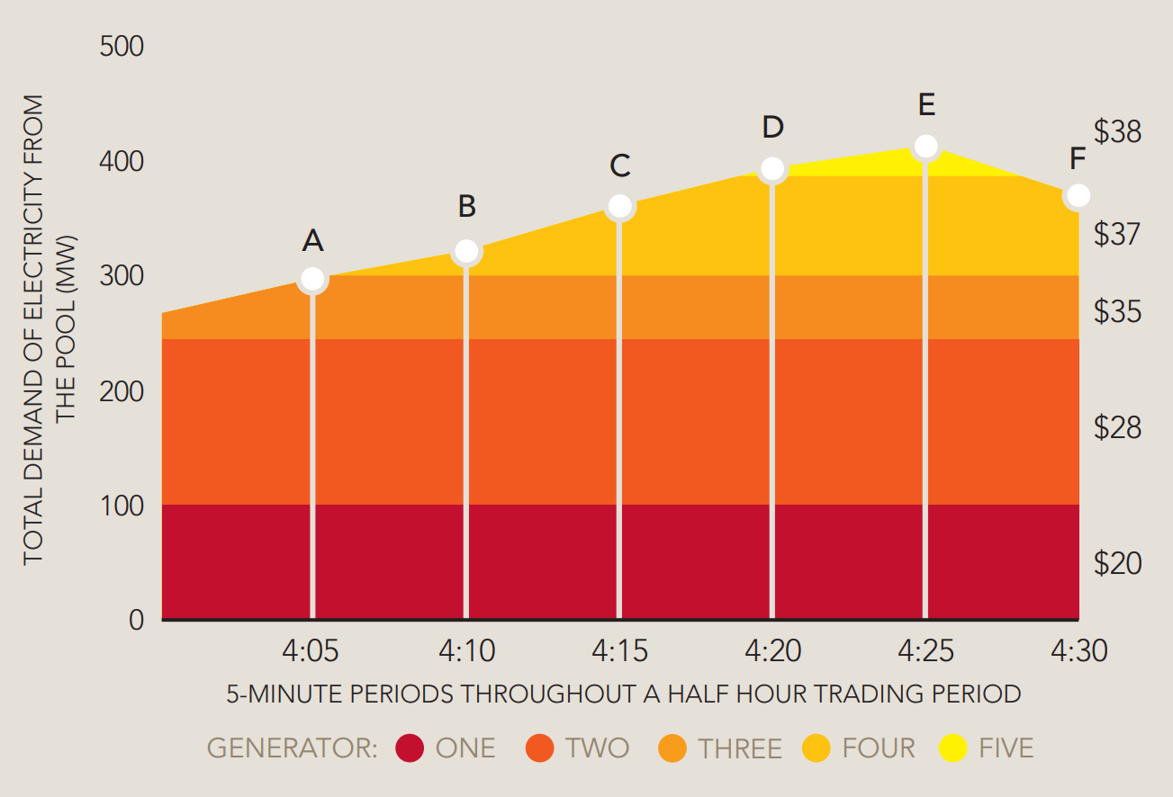
Electricity Pricing
Prices increase proportionally to current total demand (MW)
At extremey low demand generators will pay consumers to take energy (negative pricing)
Creates opportunities
Load shedding – spreading electrical demand over a longer period of time
Demand management – using power only when
Energy Storage – Batteries, Pumped Hydro
AEMO - An Introduction To Australia’s National Electricity Market July 2010

Slide 4
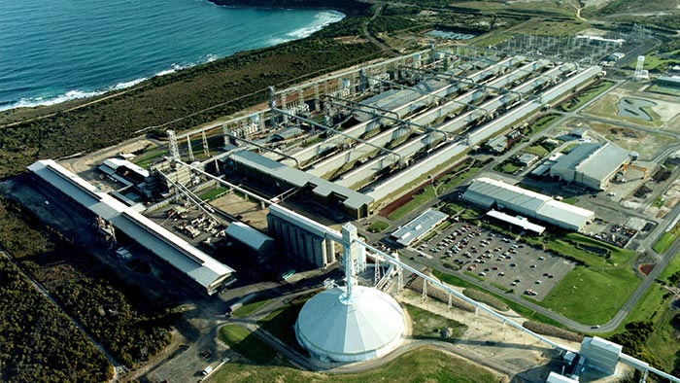
Alcoa - Portland Aluminum Smelter
How can Alcoa’s Portland Aluminum smelter use demand management to reduce its energy costs?
Uses up to 10% of Victoria's total electricity demand
Use electricity when prices are low (solar and wind generation is at its peak)
Shut down processes when energy is expensive (during peak demand hours)
Government subsidies and payments
https://reneweconomy.com.au/portland-smelter-secures-160m-energy-deal-to-stay-open-and-act-like-giant-battery/#:~:text=The%20Portland%20smelter%20can%20consume,substantial%20benefit%20to%20the%20grid.

Slide 5
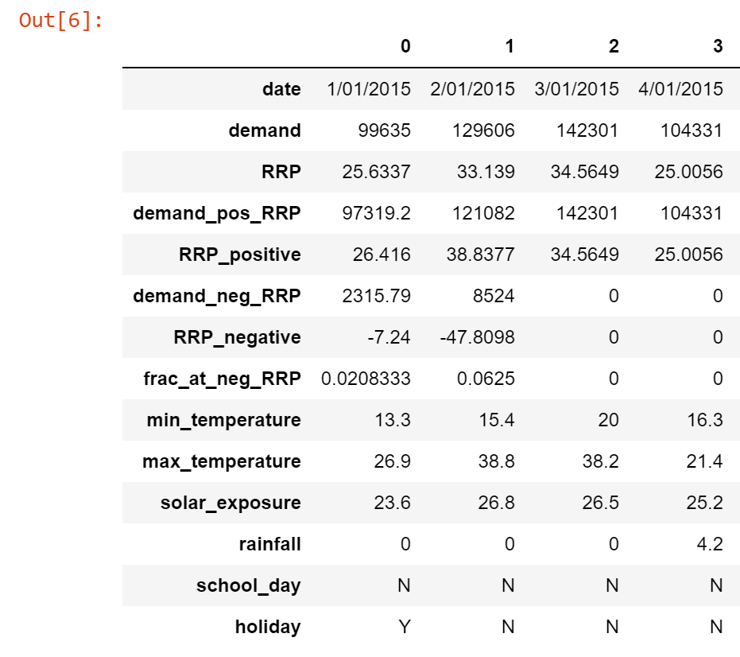
Dataset
Daily Electricity Price and Demand Data - Alex Kozlov (Kaggle)
Total Daily Electricity Demand (MWh) between 1st January 2015 and 6th October 2020 (2106 Columns)
Demand is in “Total Daily Electricity Demand” in MWhours
RRP is $AUD/MWhours

Slide 6
Data Cleaning
Convert Date to date/time
Take subsets of data -2015-2019 and 2019 only
Remove redundant columns
Remove outliers (RRP)

Slide 7
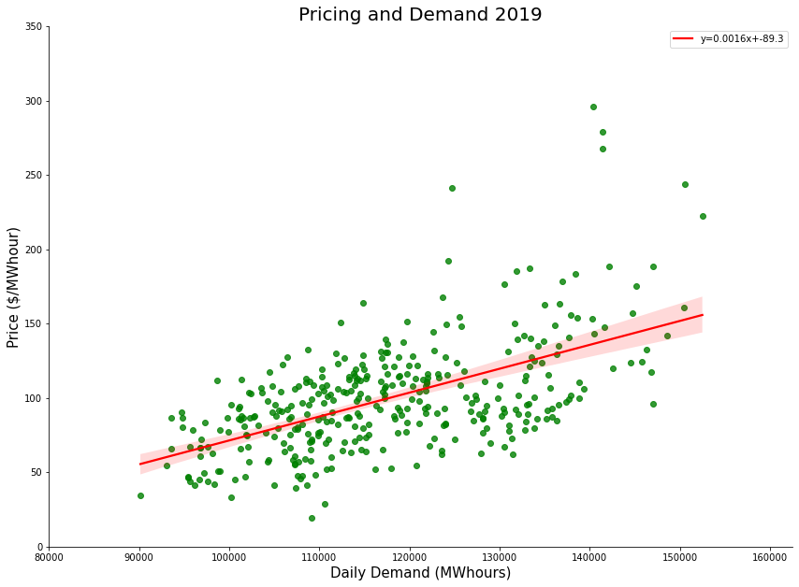
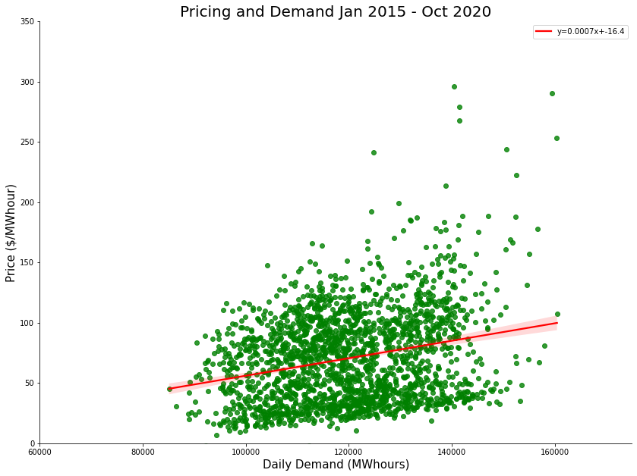
Electricity Prices and Demand

Slide 8
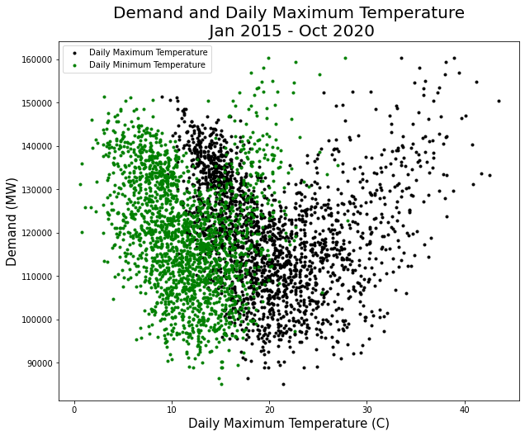
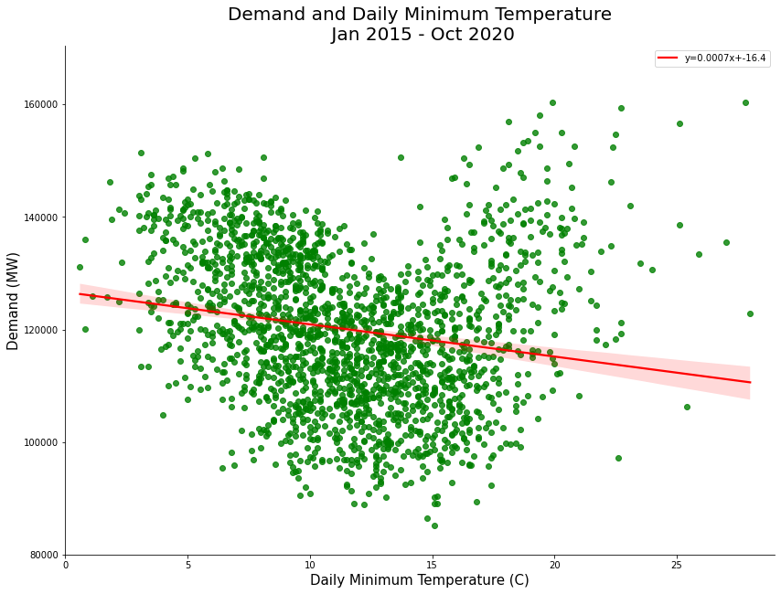
Max/Min Temperature and Demand

Slide 9
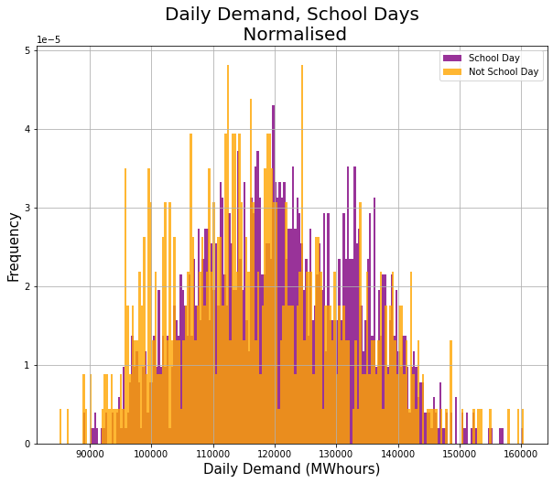
School Days
Normalised Data to account for more school days
Higher Daily Demand on School Days
Median Daily Demand for School Day = 120,718 MWhours
Median Daily Demand for Non-School Day = 116,297 MWhours

Slide 10
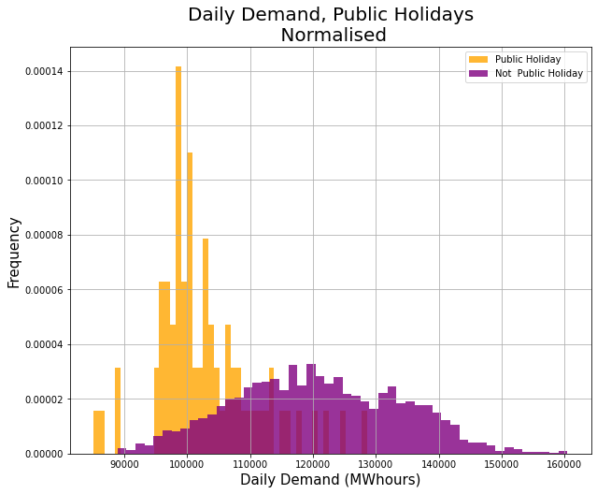
Holidays
Normalised data to account for less public holidays
Significantly Lower Daily Demand on public holidays
Median Daily Demand for Public Holiday = 100,696 MWhours
Median Daily Demand for Non-School Day = 120,086 MWhours

Slide 11
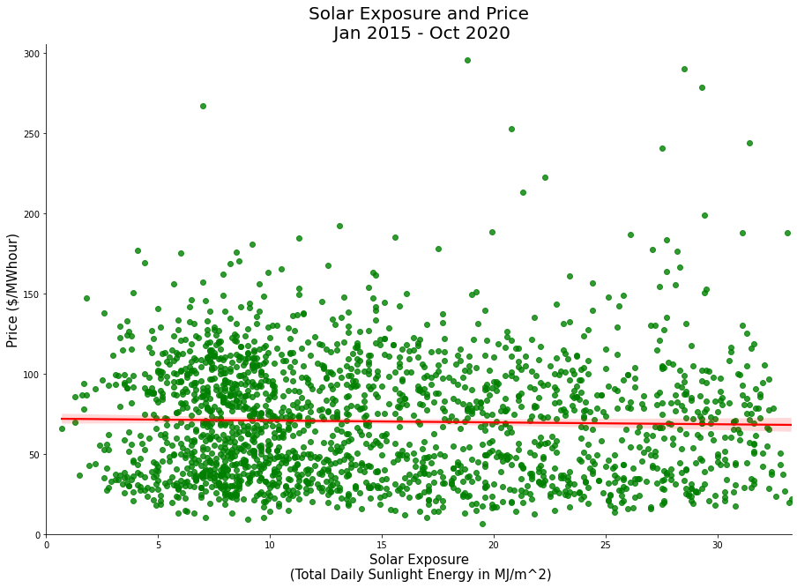
Solar Index
Hypothesis – higher solar index would correlate with lower prices due to excessive solar supply
No visible correlation between solar index and price

Slide 12
Conclusions
Electricity prices increase with higher demand
Electricity demand increases at peak minimum and maximum temperatures
Demand is lower on weekends and public holidays
There is no significant correlation between solar index and pricing

Slide 13
Next steps
Use similar data to help predict/forecast periods of low and high electricity demand
Develop strategies that Alcoa Portland Smelter can employ to benefit from this prediction
For Example
Scheduling energy consuming production processes for times with forecasted low demand
Utilizing battery storage
Load shedding with diesel/gas generators
Larger data sets with additional data features are needed

